Slide 1
Don’t Overfit! Data Analytics Project (UE17cs322)
Hardik Gourisaria PES1201700129
Mayank Agarwal PES1201701349
Amit Kumar PES1201701295

Slide 2
Problem Statement:
Given a Training Dataset with 300 features and 250 training samples, fit a Binary Classification Model to the data such that the model does not Overfit
No other information about the data is given
Test the model on unlabeled testing dataset with 300 features and 19750 testing samples
Problem Statement is taken from a Kaggle Competition

Slide 3
Domain/ Scope of the Project:
Project largely lies in the domain of Feature Engineering and Classification
Feature Engineering is required because as mentioned, the training data has 300 features and 250 training samples and hence the classification model is bound to overfit. To prevent this, dimensionality reduction is required
End target output are the class labels of the samples in the testing dataset
Hence selecting an appropriate Classification Model is of utmost importance

Slide 4
Walkthrough of the Process:
Exploratory Data Analysis
Selecting a Classification Model
Selecting a Dimensionality Reduction Technique
Implement both together
Evaluate the results

Slide 5
Exploratory Data Analysis:
Data is clean with no missing values
25 important features were selected using Extra Tree Classifiers and the heat maps were plotted. The features are not correlated
ACF and PACF plots show that the data is not a time series
Logistic Regression Model was implemented and the model was confirmed to be Overfitted

Slide 6
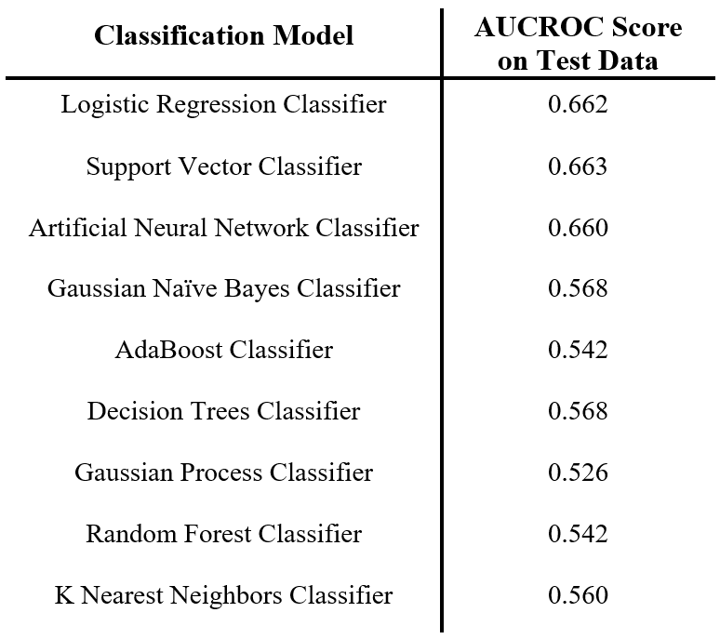
Selecting a Classification Model:
Several Classification Models were tried out
Logistic Regression Classifier, Support Vector Classifier and Artificial Neural Network produced the best result on the testing data
Due to simplicity of implementation and cost of training, Logistic Regression was selected as the Classifier Model.

Slide 7
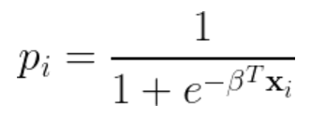
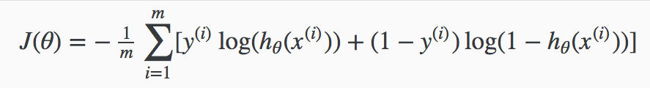
Logistic Regression
Probabilities of the target samples can be computed as indicated below:
Cost Function is as follows:

Slide 8
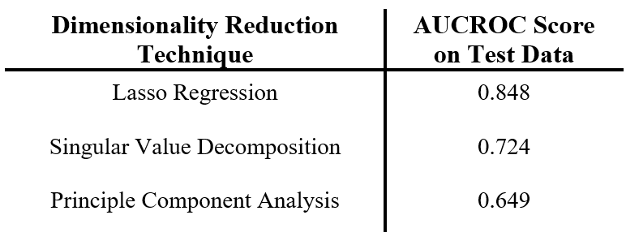
Selecting a Dimensionality Reduction Technique:
Principle Component Analysis, Singular Value Decomposition and Lasso Regression were tried out.
Lasso Regression produced the best results on the testing data and hence was selected.

Slide 9
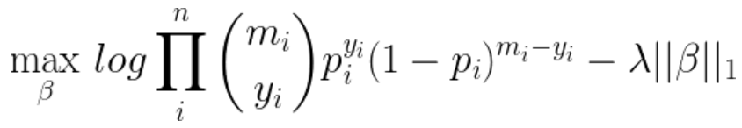
Lasso Regression
Lasso regression is a regularization technique but can be used for dimensionality technique as it sets the coefficients of the less significant features to 0.
Cost function is as mentioned above. Gradient Descent cannot be used as the Cost Function is not differentiable and hence a Linear Solver should be used.

Slide 10
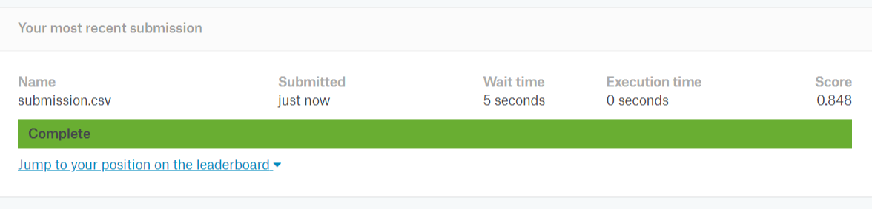
Result and Conclusion:
The Lasso Regression combined with Logistic Regression produced the best result on the test dataset
We conclude that the model does not overfit the test dataset

